Slide 1
STOR 455 Class 20
Read: 3.4, 3.6
Exercises: 3.35, 36, 37, 38, 41, 42

Slide 2
Example: State SAT Scores
Source: Statistical Sleuth, Case 12.1 pg. 339
Response Variable:
SAT =Average combined SAT Score
Potential Predictors:
Takers = % taking the exam
Income = median family income ($100’s)
Years = avg. years of study (SS, NS, HU)
Public = % public school
Expend = spend per student ($100’s)
Rank = median class rank of takers

Slide 3
R: Best Subsets for StateSAT
library(leaps)
all=regsubsets(SAT~Takers+Income+Years+Public+Expend+Rank,
data=StateSAT,nbest=2)
ShowSubsets(all)
Takers Income Years Public Expend Rank Rsq adjRsq Cp
1 ( 1 ) * 77.42 76.95 34.03
1 ( 2 ) * 73.58 73.03 47.64
2 ( 1 ) * * 84.71 84.05 10.22
2 ( 2 ) * * 80.54 79.71 24.97
3 ( 1 ) * * * 87.11 86.27 3.69
3 ( 2 ) * * * 85.84 84.91 8.21
4 ( 1 ) * * * * 87.71 86.61 3.58
4 ( 2 ) * * * * 87.67 86.57 3.72
5 ( 1 ) * * * * * 87.87 86.49 5.00
5 ( 2 ) * * * * * 87.73 86.34 5.48
6 ( 1 ) * * * * * * 87.87 86.18 7.00
SATbestmod = lm(SAT~Years+Public+Expend+Rank, data=StateSAT)

Slide 4
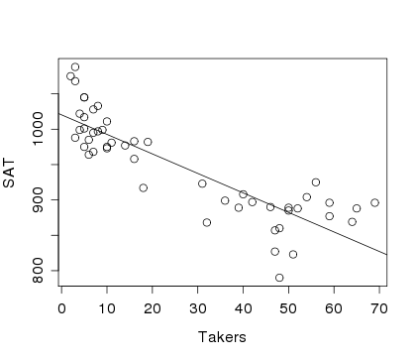
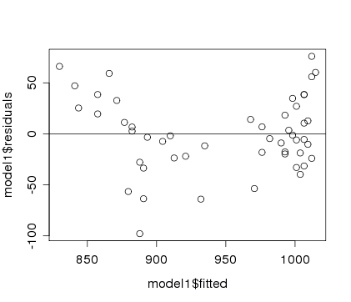
Example: State SAT
Model #1: Y=SAT vs. X=Takers
Would a “curved” line work better?
modSAT1=lm(SAT~Takers,data=StateSAT)
summary(modSAT1)
Estimate Std. Error t value Pr(>|t|)
(Intercept) 1020.3062 8.1391 125.36 < 2e-16 ***
Takers -2.7600 0.2387 -11.56 1.77e-15 ***
---
Residual standard error: 36.8 on 48 degrees of freedom
Multiple R-squared: 0.7358, Adjusted R-squared: 0.7303
F-statistic: 133.7 on 1 and 48 DF, p-value: 1.768e-15

Slide 5
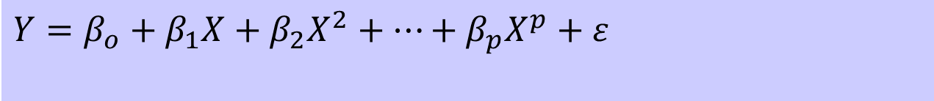
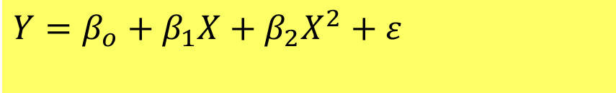
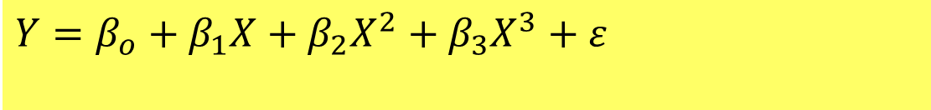
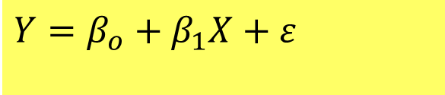
Polynomial Regression
For a single predictor X:
$$Y=β_{o}+β_{1}X+β_{2}X^{2}+⋯+β_{p}X^{p}+ε$$
$$Y=β_{o}+β_{1}X+ε$$
(linear)
$$Y=β_{o}+β_{1}X+β_{2}X^{2}+ε$$
(quadratic)
$$Y=β_{o}+β_{1}X+β_{2}X^{2}+β_{3}X^{3}+ε$$
(cubic)

Slide 6
Polynomial Regression in R
Method #1: Create new variables with predictor powers.
StateSAT$TakersSq=StateSAT$Takers^2
modSATquad1=lm(SAT~Takers+TakersSq,data=StateSAT)
To avoid creating a new variable…
Method #2: Use I( )in the lm( )
modSATquad2=lm(SAT~Takers+I(Takers^2),data=StateSAT)
Method #3: Use poly
modSATquad3=lm(SAT~poly(Takers,degree=2,raw=TRUE), data=StateSAT)

Slide 7
Quadratic model for SAT
modSATquad2 = lm(SAT~Takers+I(Takers^2),data=StateSAT)
summary(modSAT2I)
Coefficients:
Estimate Std. Error t value Pr(>|t|)
(Intercept) 1053.13112 9.27372 113.561 < 2e-16 ***
Takers -7.16159 0.89220 -8.027 2.32e-10 ***
I(Takers^2) 0.07102 0.01405 5.055 6.99e-06 ***
Residual standard error: 29.93 on 47 degrees of freedom
Multiple R-squared: 0.8289, Adjusted R-squared: 0.8216
F-statistic: 113.8 on 2 and 47 DF, p-value: < 2.2e-16
$$\hat{SAT}=1053.1−7.1616Takers+0.0710{Takers}^{2}$$

Slide 8
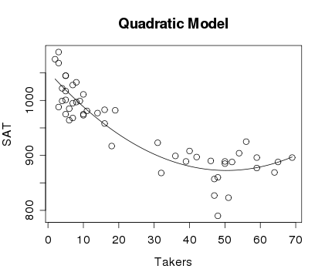
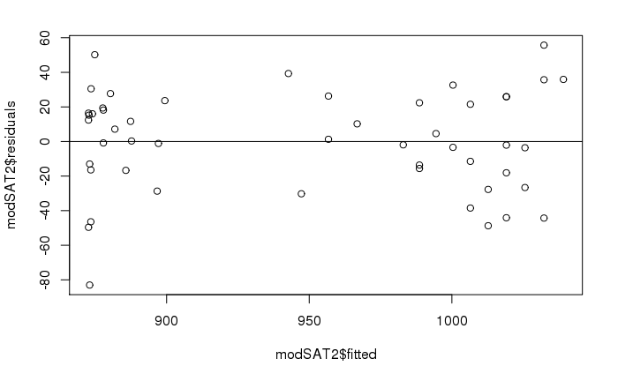
Quadratic model for SAT
plot(SAT~Takers,main="Quadratic Model",data=StateSAT)
B0_modSATquad2 = summary(modSATquad2)$coef[1,1]
B1_modSATquad2 = summary(modSATquad2)$coef[2,1]
B2_modSATquad2 = summary(modSATquad2)$coef[3,1]
curve(B0_modSATquad2 + B1_modSATquad2*x
+ B2_modSATquad2*x^2, add=TRUE)

Slide 9
Would a Cubic work better?
modSATcubic = lm(SAT~Takers+I(Takers^2)+I(Takers^3),data=StateSAT)
summary(modSATcubic)
Estimate Std. Error t value Pr(>|t|)
(Intercept) 1.051e+03 1.452e+01 72.366 < 2e-16 ***
Takers -6.753e+00 2.380e+00 -2.837 0.00676 **
I(Takers^2) 5.631e-02 8.051e-02 0.699 0.48777
I(Takers^3) 1.408e-04 7.586e-04 0.186 0.85353
---
Residual standard error: 30.24 on 46 degrees of freedom
Multiple R-squared: 0.829, Adjusted R-squared: 0.8178
F-statistic: 74.33 on 3 and 46 DF, p-value: < 2.2e-16
modSATquad2 = lm(SAT~Takers+I(Takers^2),data=StateSAT)
summary(modSATquad2)
Residual standard error: 29.93 on 47 degrees of freedom
Multiple R-squared: 0.8289, Adjusted R-squared: 0.8216
F-statistic: 113.8 on 2 and 47 DF, p-value: < 2.2e-16

Slide 10
Nested F-test
$$SAT =β_{0}+β1Takers+_{2}Takers2+ 3Takers3+ε$$
H₀: β₃=0
H_{a}: Some β₃≠0
anova(modSATquad2, modSATcubic)
Analysis of Variance Table
Model 1: SAT ~ poly(Takers, degree = 2, raw = TRUE)
Model 2: SAT ~ Takers + I(Takers^2) + I(Takers^3)
Res.Df RSS Df Sum of Sq F Pr(>F)
1 47 42101
2 46 42069 1 31.524 0.0345 0.8535

Slide 11
Second Order Models
Definition: A second order model for two quantitative predictors would be
$$Y=β_{o}+β_{1}X_{1}+β_{2}X_{2}+β_{3}X_{1}^{2}+β_{4}X_{2}^{2}+β_{5}X_{1}X_{2}+ε$$
first order
quadratic
interaction
second order
Example: Try a full second order model for
Y=SAT using X₁=Takers and X₂=Expend

Slide 12
Second Order Model for State SAT
modSAT2ndorder = lm(SAT~Takers+Expend+I(Takers^2)+I(Expend^2)+I(Takers*Expend),data=StateSAT)
summary(modSAT2ndorder)
Coefficients:
Estimate Std. Error t value Pr(>|t|)
(Intercept) 893.66283 36.14094 24.727 < 2e-16 ***
Takers -7.05561 0.83740 -8.426 9.96e-11 ***
Expend 10.33333 2.49600 4.140 0.000155 ***
I(Takers^2) 0.07725 0.01328 5.816 6.28e-07 ***
I(Expend^2) -0.11775 0.04426 -2.660 0.010851 *
I(Takers * Expend) -0.03344 0.03716 -0.900 0.373087
---
Residual standard error: 23.68 on 44 degrees of freedom
Multiple R-squared: 0.8997, Adjusted R-squared: 0.8883
F-statistic: 78.96 on 5 and 44 DF, p-value: < 2.2e-16
Do we need the interaction term?
Do we need the second order terms?
Do we need the terms with Expend?

